Slide 1
M.A.M College of Engineering
Simplistic Online Voting System
Team,
Ganesh M (812618205008)
Santhosh I (812618205016)
Vijayakumar M (812618205023)
Guided by,
Mrs.K.Udhaya Suriya,
Assistant Professor, Department of
Information Technology

Slide 2
Agenda:
Abstract
Introduction
Literature review
Objective
Blockchain
Base64 encoding
Hardware requirement
Software requirement
Existing system
Proposed system
Module Description
Result
Conclusion
Reference

Slide 3
ABSTRACT:
The online voting system provides a convenient, easy and efficient way to vote eliminating the shortcomings of traditional approach.
The proposed project is to build an E-Voting system which is basically an online voting system through which people can cast their vote through internet.
To achieve the required security OTP (one time password) and Fingerprint verification approach is used, which is most common on the web to tell the difference between a human using a web service and an automated bot thus making the website more secure against spam-bot attacks. So that fraudulent can be eliminated using this technique.
Multiple voting are eliminated by checking particular voter already polled their vote or not. If the voter already polled their vote they will not be allowed to vote again.

Slide 4
INTRODUCTION:
Voting system is the pillar of every democracy in which voters choose their leaders to show their presence for the way that they will be supervised.
Voting scheme have grown from counting hands in previous days to system that include papers, punch card, optical scan machine and mechanical lever i.e., to the electronic voting system. This traditional voting system is the time-consuming process therefore maximum of people is not able to vote because of their busy schedule.
The fundamental idea behind secure online voting system to conquer inability of the conventional voting system as it suffers from various drawbacks such as it consumes huge volume of paper work, time, there is no personal role of higher officers, damage of electronic machines due to lack of attention. Secure online voting system is the system through which any voter can vote from anywhere at any time.

Slide 5
LITERATURE REVIEW:
S\No | Paper Title (Author Name, Title of the paper, Publication Name, Year of publication) | Technique | Merits | Demerits
1. | Performance Improvement using Pseudorandom One Time Password (OTP) in Online Voting System,(IOSR Journal of Computer Engineering (IOSR-JCE), Preeti Ahlawat, Rainu Nandal, (Sep. – Oct. 2015) | Pseudorandom Algorithm | The foremost advantage of and primary reason for OTPs is security. Since a single-use password will change with each login attempt, to avoid the risk | Delay in arrival of OTP ultimately causes delay in transaction completion which could sometimes lead to failure
2. | Faster Base64 Encoding and Decoding Using AVX2 Instructions., ACM Journals, Wojciech Muła, Daniel Lemire (17 – July - 2018) | Base64 Encoding | It converts the binary data into text and the number of bytes will increased. So that The naked eye can't directly see the original content. | Base64 cannot be cached. To cache, you can only cache files containing Base64, such as JS or CSS, which is much worse than directly caching pictures. Generally, HTML changes are frequent, so it is equivalent to no caching benefit.

Slide 6
CONT…
S\No | Paper Title (Author Name, Title of the paper, Publication Name, Year of publication) | Technique | Merits | Demerits
3. | Fingerprint Voting System Using Arduino , (International Journal of Scientific Research in Computer Science, M.Nathiya, C. Sivakaran, N.Thiruchchelvan, and K.Thiruthanigesan, 2017) | Using Arduino | for the user they are simple and easy to use. No more struggling to remember your last password or being locked out due to leaving your photo ID at home. Your fingerprints are always with you. | scanners are subject to the same technical failures and limitations as all other electronic identification systems such as power outages, errors and environmental factors.
4. | Blockchain-Based E-Voting System, 2018 IEEE 11th International Conference on Cloud Computing, Friðrik Þ. Hjálmarsson, Gunnlaugur Mohammad Hamdaqa, Gísli Hjálmtýsson, 10 September 2018 | Blockchain Technology | Hacking the block chain is difficult because it requires a huge power for processing | It is complex to design and build the a secure block chain system than the comparable centralize system

Slide 7
OBJECTIVE:
To build an online system this would enable voters to cast their votes through internet.
Create a secure authentication facility to check validate users logging into the voting system.
Create a database to be used to store votes, and user information on the system.
Study and implement a security method to be used to ensure that votes being cast in the system will not be compromised to any outside attack.

Slide 8
CONT…
Create tools for the administrator to add, delete and update details of voters, candidates and administrators on the system.
Enable administrators to generate reports on the vote results.
Prevent voters from voting more than once.

Slide 9
BLOCKCHAIN
Blockchain is an ordered data structure that contains blocks of transactions.
Each block in the chain is linked to the previous block in the chain.
The first block in the chain is referred to as the foundation of the stack.
Each new block created gets layered on top of the previous block to form a stack called a Blockchain.
The first transaction added to the block will be a special transaction that represents the candidate.
When this transaction is created it will include the candidate's name and will serve as the foundation block, with every vote for that specific candidate placed on top of it.
Unlike the other transactions, the foundation will not count as a vote, and it will only contain the name of the candidate.

Slide 10
BASE64 ENCODING
Base64 encoding algorithm is used to formats and represent arbitrary binary data as text.
Base64 is part of the MIME email protocol, used to encode binary attachments.
Base64 formats encode arbitrary bytes into a stream of characters chosen from a list of 64 ASCII characters. Three arbitrary bytes can be encoded using four ASCII characters.
Base64 encoding takes the original binary data and operates on it by dividing it into tokens of three bytes. A byte consists of eight bits, so Base64 takes 24bits in total. These 3 bytes are then converted into four printable characters from the ASCII standard.

Slide 11
HARDWARE REQUIREMENT
Any device (mobile, tablet, laptop, computer) with internet
Fingerprint scanner (MFS100).
SOFTWARE REQUIREMENT
Internet browser.

Slide 12
EXISTING SYSTEM
Paper-based voting
The voter gets a blank ballot and use a pen or a marker to indicate which candidate to vote. Hand-counted ballots are a time and labour consuming process, but it is easy to manufacture paper ballots and the ballots can be retained for verifying, this type is still the most common way to vote.

Slide 13
CONT…
Lever voting machine
Lever machine is peculiar equipment, and each lever is assigned for a corresponding candidate. The voter pulls the lever to poll for his favorite candidate.
Punch card
The voter uses metallic hole-punch to punch a hole on the blank ballot. It can count votes automatically.

Slide 14
DISADVANTAGES
The existing system of election is running manually.
The voter has to visit to booths to vote a candidate so there is wastage of time.
Vote counting has to be done manually.
There are Electronic voting machines used which takes more cost.

Slide 15
PROPOSED SYSTEM
Proposing the new system of online voting system, where the voting is conducted through internet.
This proposed system will conduct voting very simply and easily with also take care of all the security needs.
In this system voters will have to login with their given user id and password and then complete both OTP and Biometric authentications to vote. They don’t need to go to booth for voting.

Slide 16
MODULE DESCRIPTION
The proposed online voting system contains two main modules,
a) Voter module
b) Admin module
VOTER MODULE
This module is the module where voters can vote for candidates. This module has access to all the users of the system. In this module first voter have to login with his/her user id and password. After login a six-digit OTP is sent to the voters register mobile number. That OTP is verified by the voter. Next step is to verify the registered fingerprint. After all the steps, voter can choose his/her candidate and vote.

Slide 17
CONT…
ADMIN MODULE
This module is only accessible for who own’s the system or the administrator of the system. Using this module administrator can conduct voting, add or remove voters, candidates and administrators, view the results of the voting. Administrator module has 4 sub-modules,
Candidate module
Voting module
Voter module
Settings module

Slide 18
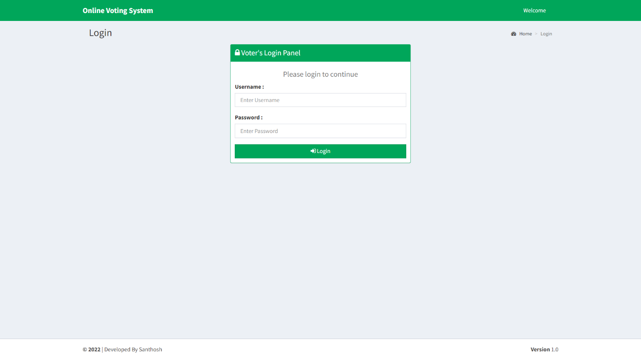
RESULT
Voter login page
Each voter has a unique voter id and password. Using them they can login.

Slide 19
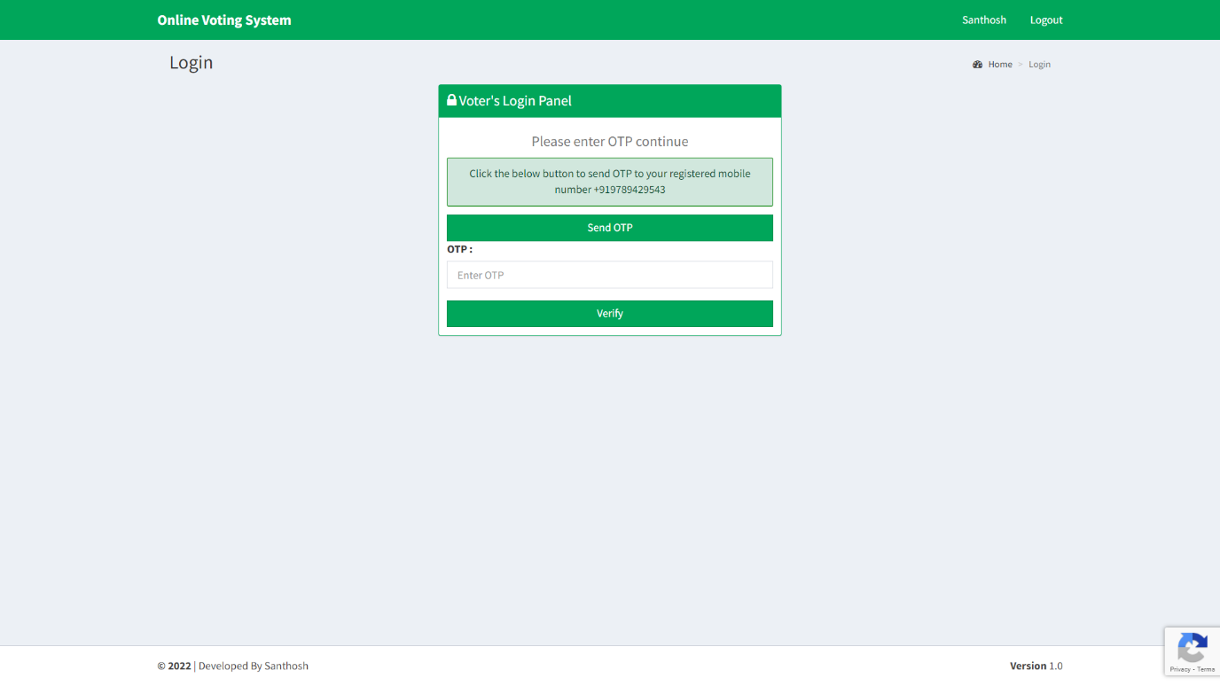
OTP verification page
Voters have authenticate their registered mobile number by clicking the send OTP button and verify the OTP received in their registered mobile number

Slide 20
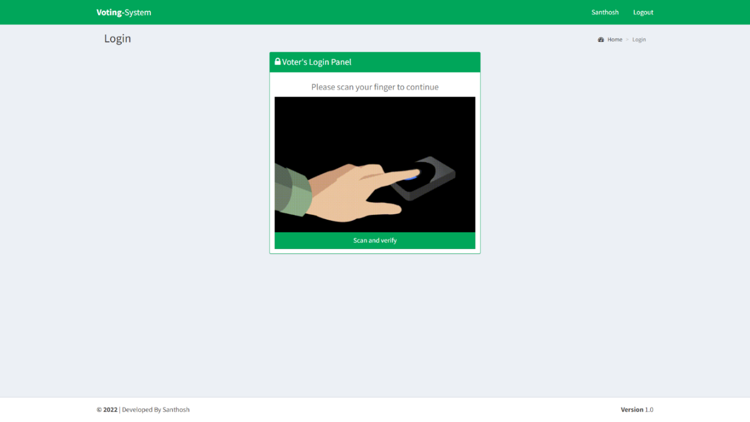
Fingerprint verification page
Voters have to verify their fingerprint they gave during the voter registration process for proceeding to the voting page.

Slide 21
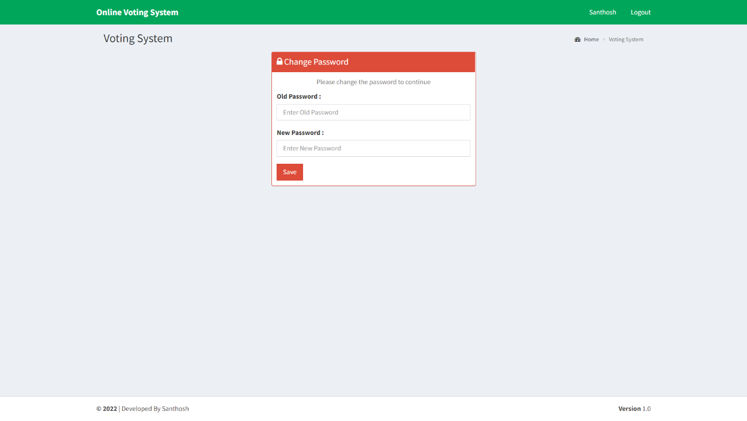
Password reset page
When a registered voter logged in for the first time they will be asked for reset their password because, when the user id created by administrator the user id and password are to be the same.

Slide 22
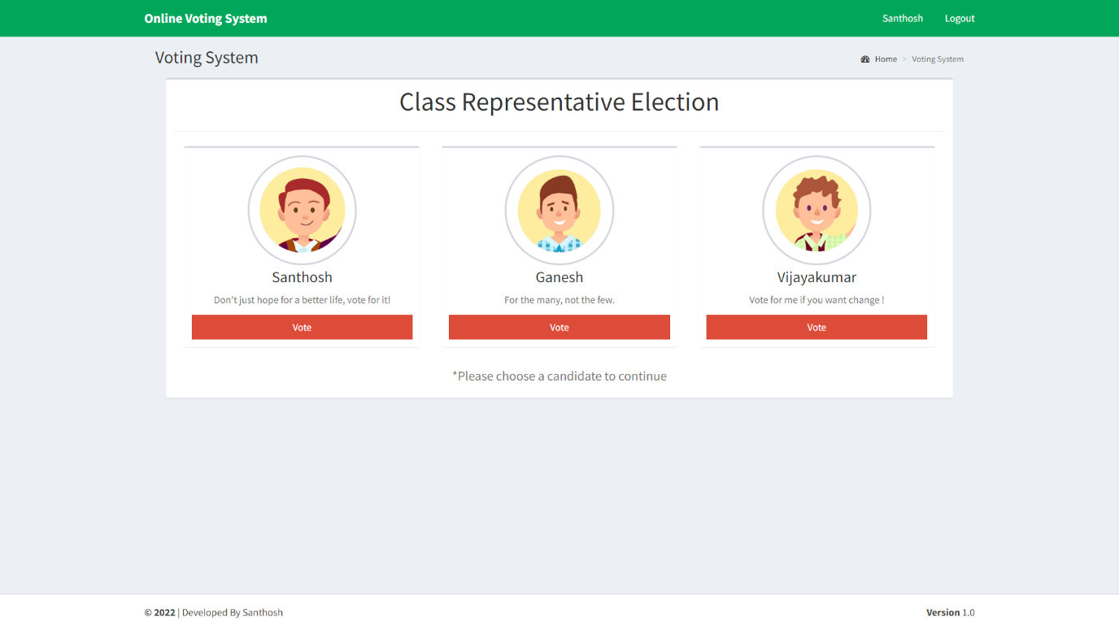
Voting page
After all the authentication processes are completed the voter will presented with the voting page where they can select to which candidate they vote for.

Slide 23
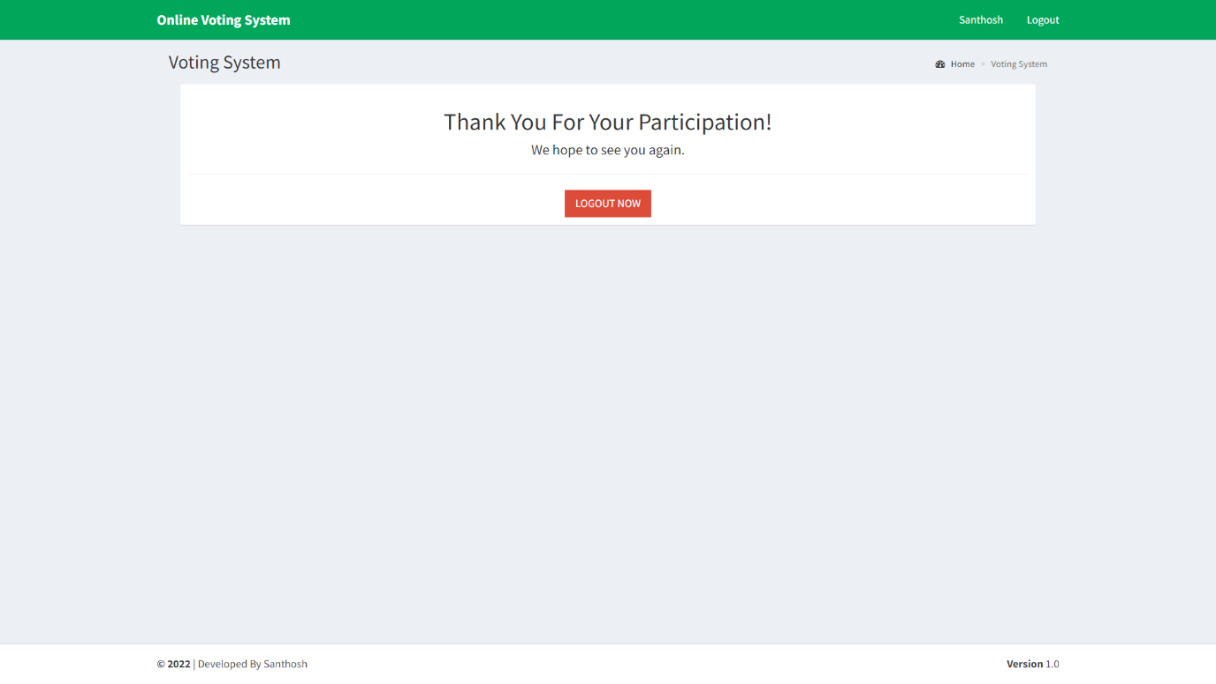
Voting page after voted
Once a voter casted their vote they can’t visit the visiting page again and vote again. Alternatively they will redirected to this thankyou page.

Slide 24
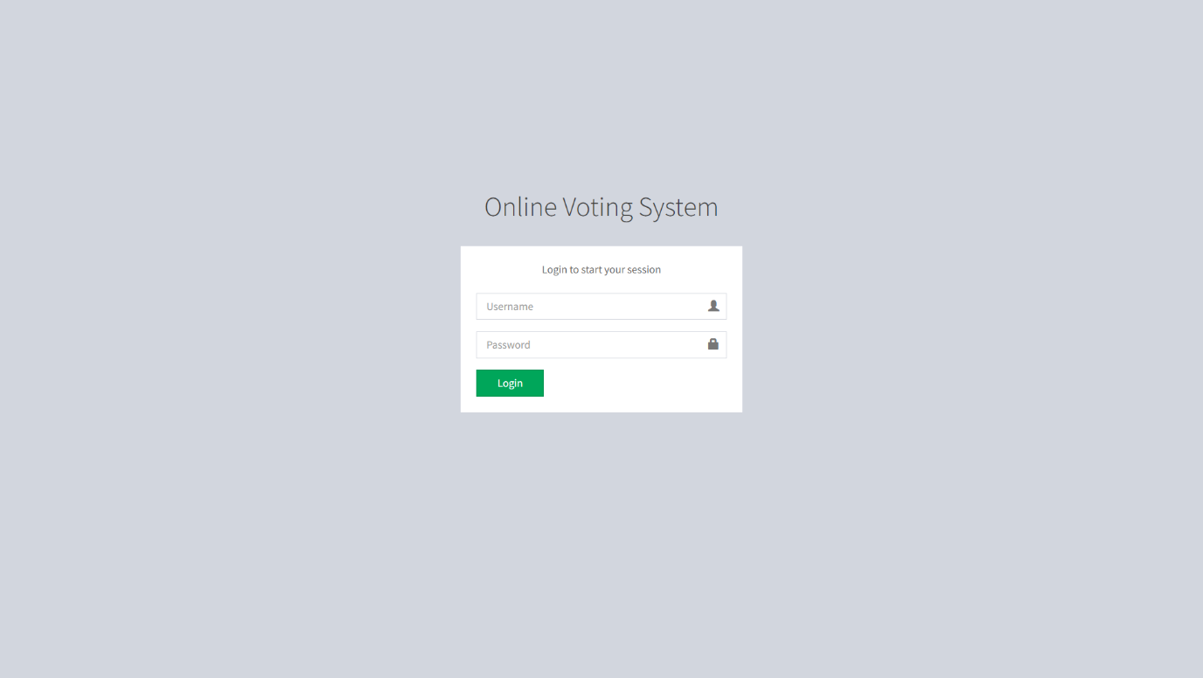
Administrator login page
This page is responsible for system administrator login. Only administrators can login in this page.

Slide 25
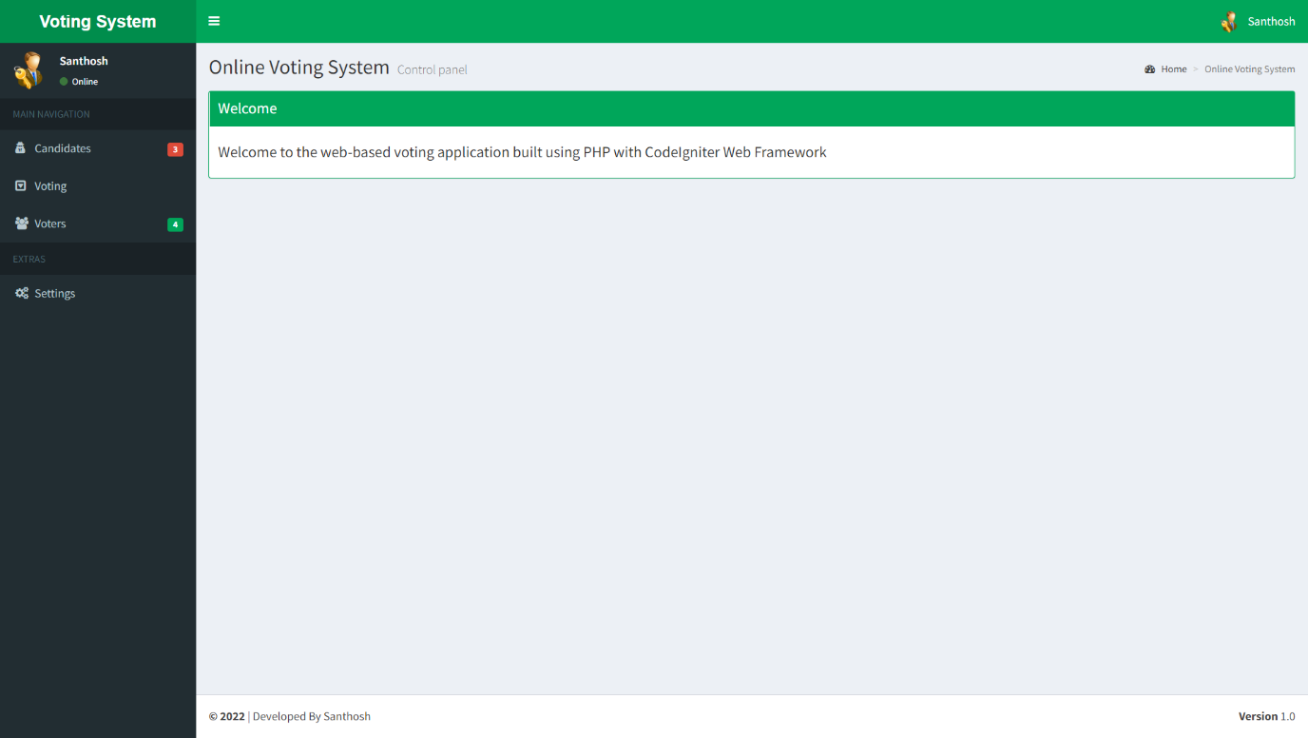
Administrator welcome page
When an administrator logged in they will be presented with this welcome page of the administrator module.

Slide 26
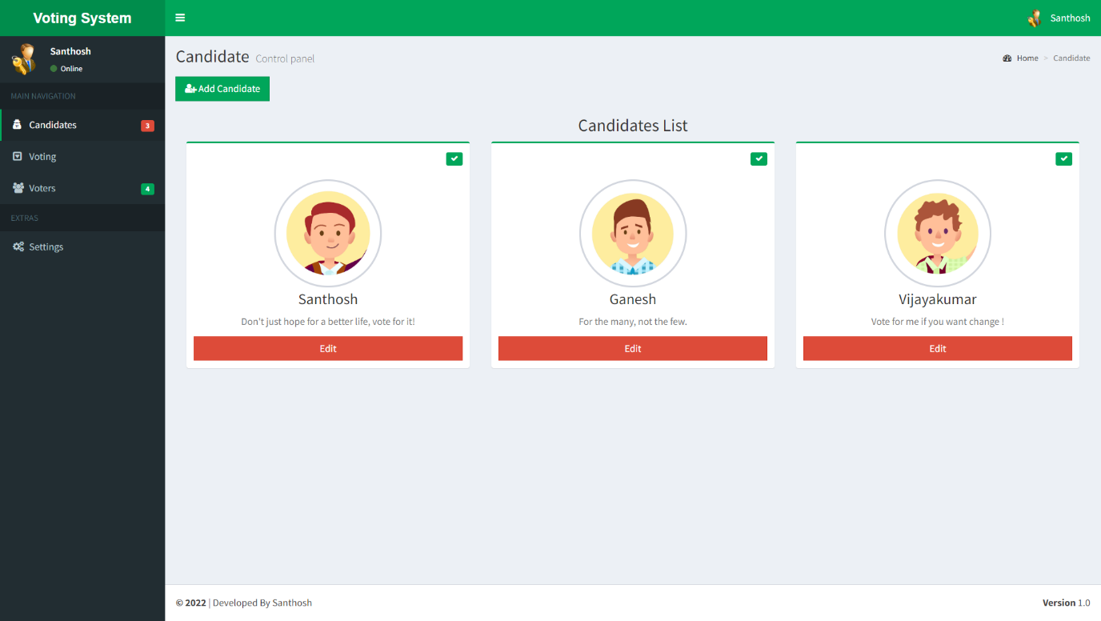
Candidates page
This page shows all the candidates registered for the election. And differentiate them by who are participated in the current voting process or not by showing a green tick in the upper right corner of their profile.

Slide 27
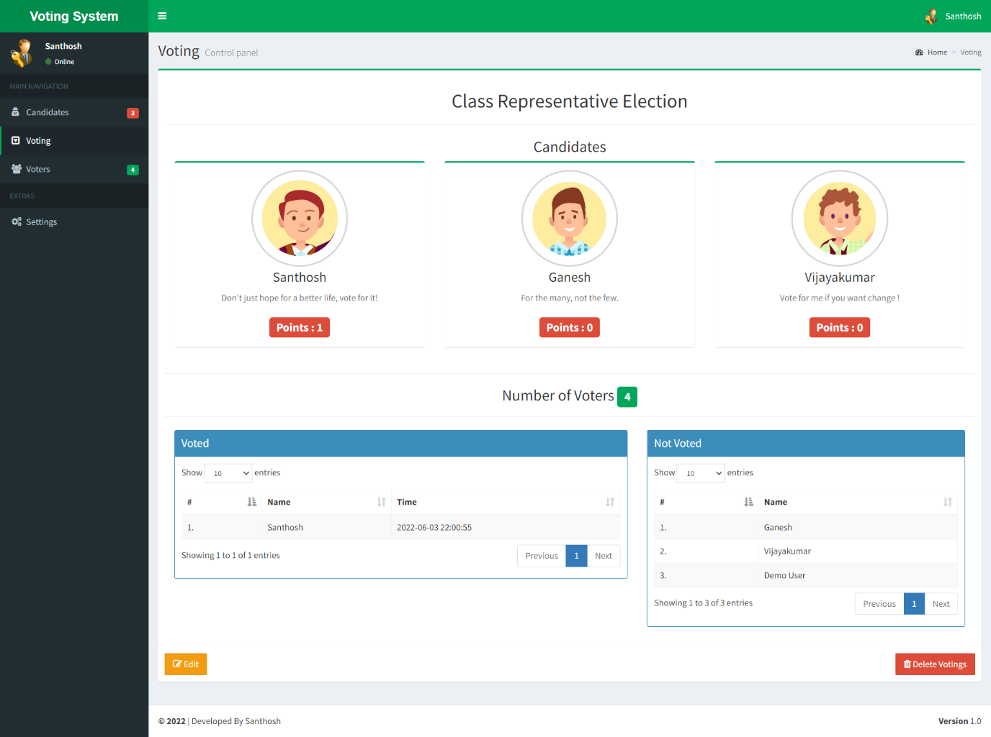
Voting management page
The voting process is started from this page by the administrator. Election name and candidates who are participating are chosen from here. And also, all the current live voting details are displayed here like how much vote each candidate got, who are voted and not

Slide 28
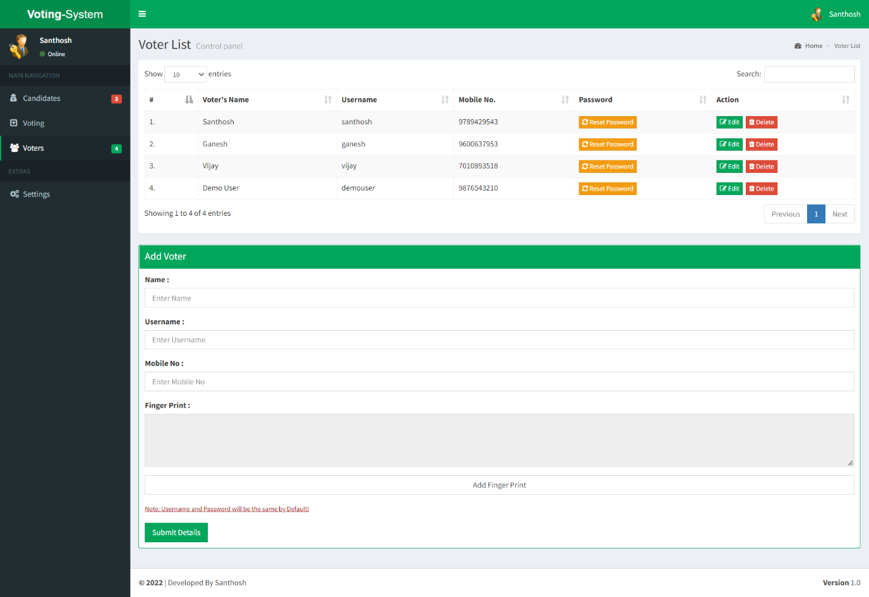
Voters page
This page displays all the details of the voters who are registered in this system. And also this page is responsible for registering new voters to the system

Slide 29
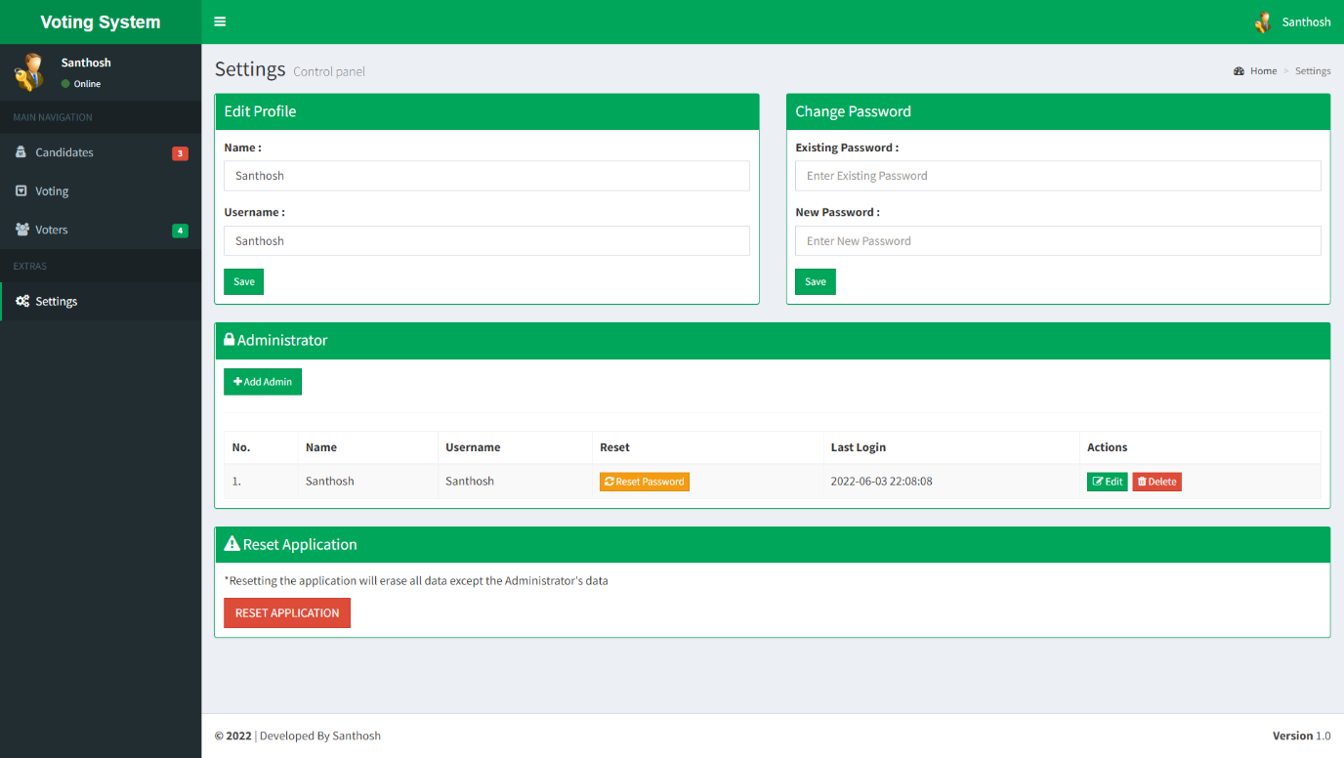
Voters page
This page has all the administrator details. It is responsible for adding new administrator, deleting administrator, reset their passwords and edit their details.

Slide 30
CONCLUSION:
Online Voting Systems have many advantages over the traditional voting system.
Using this system voter cast his/her voter through internet.
Some of these advantages are less cost, faster generation results, easy accessibility, accuracy, and low risk of human and mechanical errors.
It is very difficult to develop online voting system which can allow security and privacy on the high level.
Future development focused to design a system which can be easy to use and will provide security and privacy of votes on acceptable level by proper authentication and processing section. It is easy to use and it is less time consuming. It is very easy to debug.

Slide 31
REFERENCE:
[1] Performance Improvement using Pseudorandom One Time Password (OTP) in Online Voting System,(IOSR Journal of Computer Engineering (IOSR-JCE),Preeti Ahlawat, Rainu Nandal, (Sep. – Oct. 2015)
[2] Online Voting System Security based on Cryptography,
INTERNATIONAL JOURNAL OF ENGINEERING RESEARCH & TECHNOLOGY
(IJERT),Warish Patel, Monal Patel, Bhupendra Ramani, 17-06-2021.
[3] Fingerprint Voting System Using Arduino, (International Journal of Scientific Research in Computer Science, M.Nathiya, C. Sivakaran, N.Thiruchchelvan, and K.Thiruthanigesan,(2017)
[4] Blockchain-Based E-Voting System, 2018 IEEE 11th International Conference on Cloud Computing,Friðrik Þ. Hjálmarsson, Gunnlaugur Mohammad Hamdaqa, Gísli Hjálmtýsson, 10 September 2018

